Slide 1
Platinum Data Project Wang Biyuan
2016.08.2 Presentation

Slide 2
Project Outlines
Step I: Learn about key parameters of measurement
Step II: Import data into MATLAB
Step III: Data interpolation
Step IV: Data average

Slide 3
Step I: Learn about key parameters of measurement
Machine type: Agility, MLCi2
File format: .asc
Photon energy level: 4MV, 6MV, 10MV, 15MV, 18MV
Field size (FSZ): 补充
Curve type: Profile & PDD
Source to surface distance (SSD): 900mm & 1000mm
Notes:
By either truncation or interpolation

Slide 4

Step I: Learn about key parameters of measurement
Recap: Step II Data Interpolation
Aim: ensure the consistency of data length
400
400
400
Notes:
By either truncation or interpolation

Slide 5
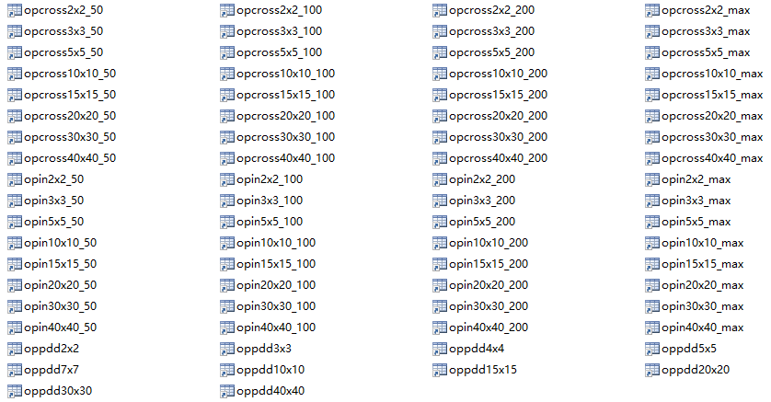
Project Progress
Recap: Step II Data Interpolation
Preparation :
Extracted raw data & Classified raw data
Data with the same category is ready for interpolation

Slide 6
Project Progress
Step II: Data Interpolation
Syntax: ynew=interp1(x,y,xnew) —— 1-D interpolation
Input:
X – sample points
Y – sample values
Xnew – query points
Eg. X = 0:pi/4:2*pi Y = sin(X)
X and Y satisfy a function of one-one mapping relationship
Output:
Ynew – interpolated values at query points

Slide 7
Project Progress
Step II: Data Interpolation
Function: ynew=interp1(x,y,xnew)
X=axis;
Y=dose;
Xnew=x(1):0.1:x(end);
Ynew=interp1(x,y,xnew,’method’);
Method:
- Currently applied ‘spline’

Slide 8
Project Progress
Step II: Data Interpolation
Function: ynew=interp1(x,y,xnew)
Plot(xnew,ynew);
Hold on;
Plot(x,y);

Slide 9
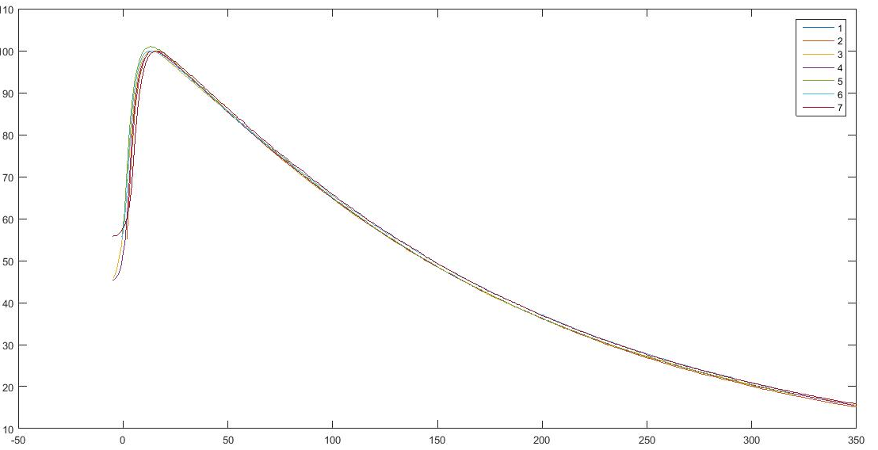
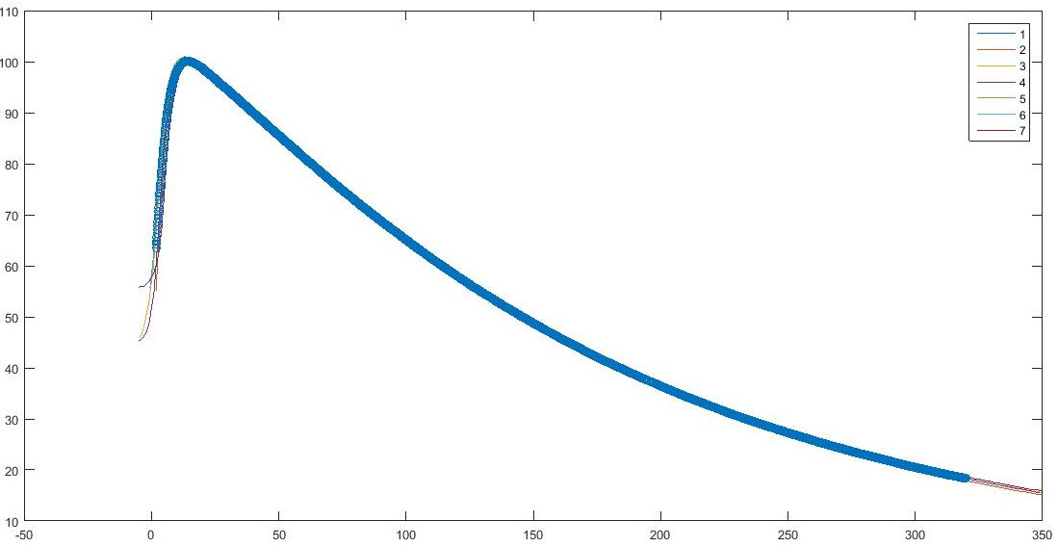
Project Progress
Step II: Data Interpolation
Function: ynew=interp1(x,y,xnew)

Slide 10
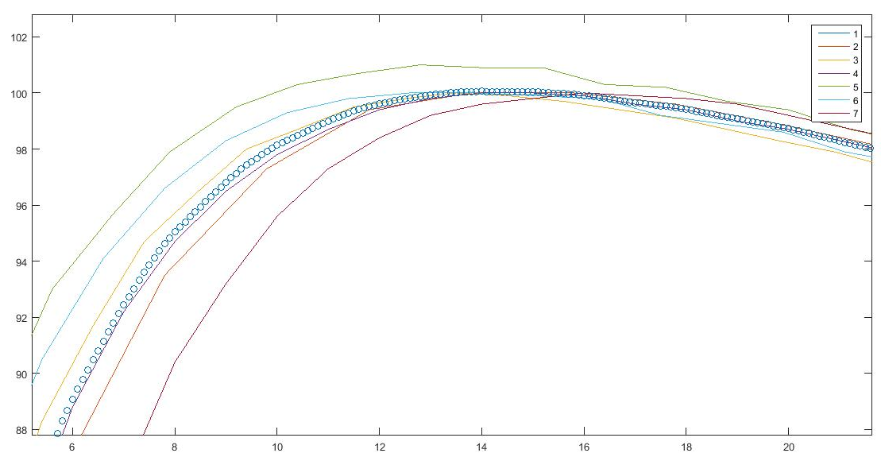
Project Progress
Step II: Data Interpolation

Slide 11
Project Progress
Step I: Import data into MATLAB
Improvement:
Previously: Nx6 matrix
Previously: Nx6 matrix
FSZ | FSZ | X | Y | Z | DOSE
Now: Nx7 matrix
FSZ | FSZ | X | Y | Z | DOSE | WEDGE

Slide 12
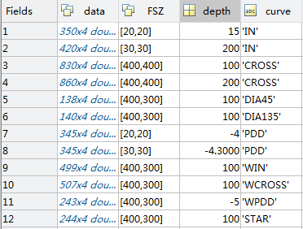
Project Progress
Step I: Import data into MATLAB
Improvement:
Import data from each file into one struct
Convenience of classification:
Avoid more for loop

Slide 13
Future Work Plan
The interpolation method anlysis
More Improvements of import data and classification functions

Slide 14
THE END Thank you for your patience!

